Slide 1
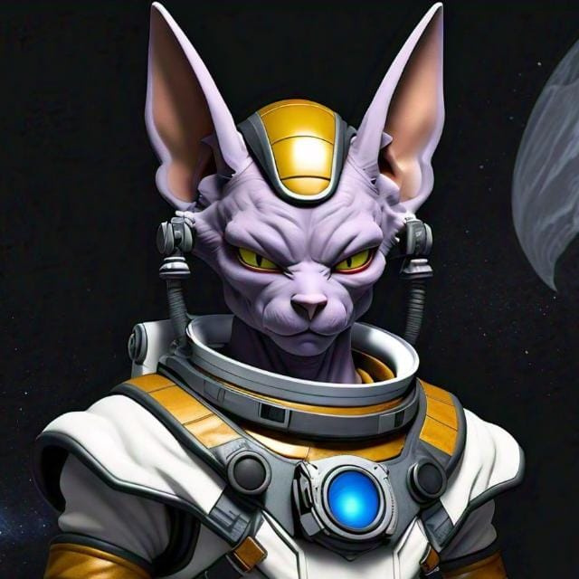

TECH BEERUS

Slide 2
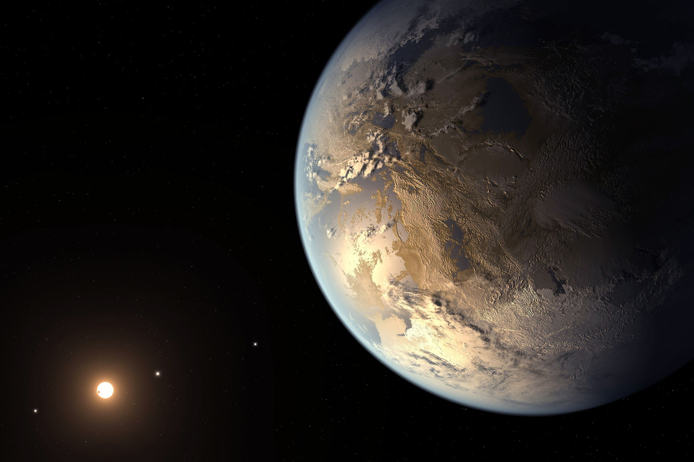
CHRONICLES OF EXOPLANET EXPLORATION

Slide 3
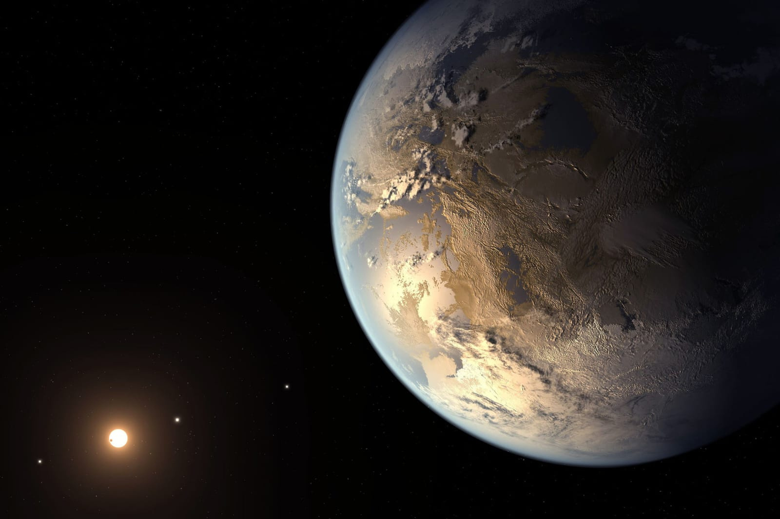
TEAM OVERVIEW: ROLES AND RESPONSIBILITIES
PARTICIPANTS
ROLES
RICK BHATTACHRYA
JAGINDRA NARAYAN DAS NISHANT
SAYAN PAL
PRANSHU PUSHKAR
DIVYESH RAKESH
INTEFACE+CODE
GAME CODE
PRESENTATION
WEBSITE
QUIZ
QUIZ

Slide 4
APPLICATION OVERVIEW
OUR INTERACTIVE APP REVOLUTIONIZES EXOPLANET EDUCATION WITH SIMPLIFIED INFORMATION ON THEIR DISCOVERY . FEATURES FUN QUIZZES TO TEST KNOWLEDGE AND
DEEPEN UNDERSTANDING,
ALONG WITH ENGAGING GAMES THAT CHALLENGE USERS WHILE ENHANCING THEIR GRASP OF EXOPLANETARY SCIENCE.
Basic Exoplanet Information
Quizzes
Games

Slide 5
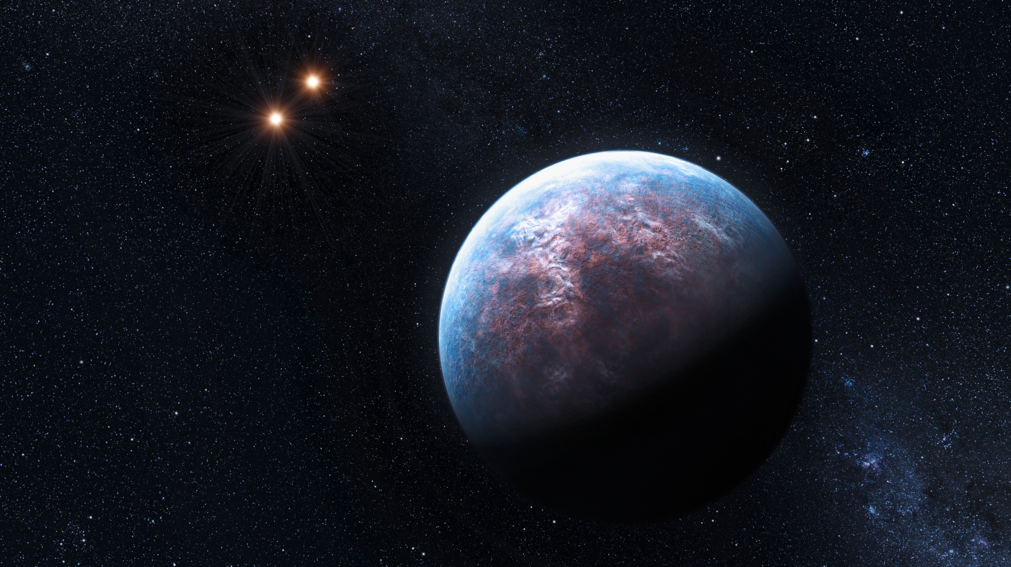
APPLICATION OVERVIEW
THIS SOLUTION EMPOWERS STUDENTS, ESPECIALLY FROM UNDERSERVED COMMUNITIES, TO EXPLORE THE WONDERS OF EXOPLANETS IN AN EXCITING AND ACCESSIBLE WAY.
KEPLER-186F
GLIESE 667

Slide 6

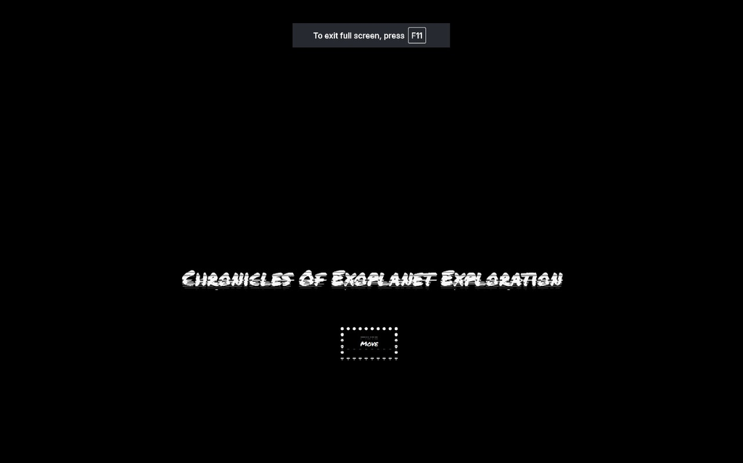
EXPLORE OUR APPLICATION: FEATURES AND ACCESS
INTRO :

Slide 7
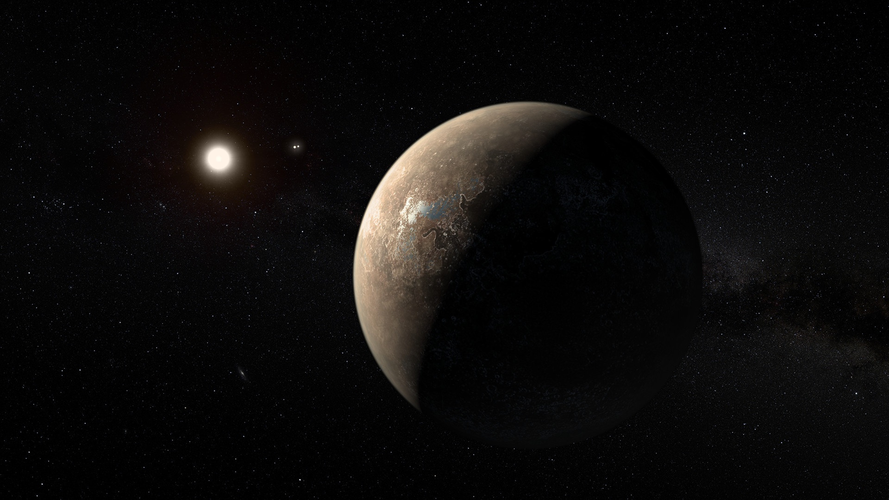
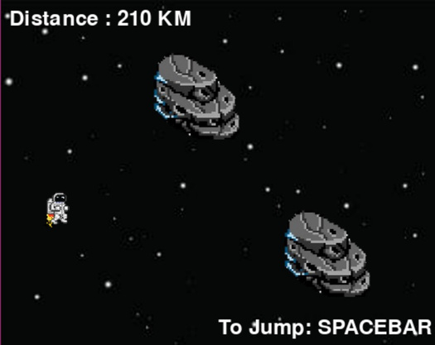
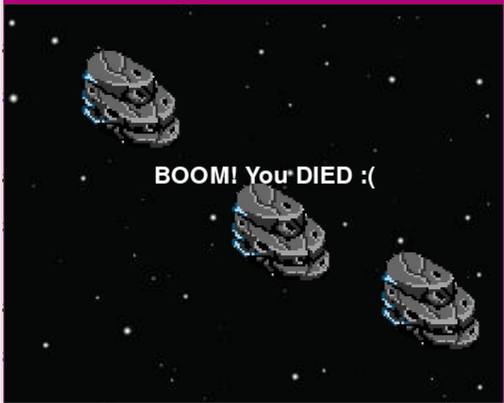
EXPLORE OUR APPLICATION: FEATURES AND ACCESS
ADVENTURE GAME:
IN THIS ASTRONAUT ADVENTURE GAME, INSPIRED BY FLAPPY BIRD, PLAYERS GUIDE AN ASTRONAUT THROUGH OBSTACLES LIKE ASTEROIDS AND PLANETS, EACH LABELED BY NAME. AS THEY JOURNEY BEYOND THE MILKY WAY, PLAYERS LEARN ABOUT THE PLANETS THEY ENCOUNTER. IT'S A FUN AND EDUCATIONAL CHALLENGE THAT SIMULATES AN OUT-OF-THIS-WORLD EXPERIENCE.

Slide 8

EXPLORE OUR APPLICATION: FEATURES AND ACCESS
INTERACTIVE QUIZZES:
Our quizzes are designed to test knowledge in an exciting, dynamic way. Each quiz is filled with thought-provoking questions about exoplanets, planetary systems, and the broader universe. Players receive instant feedback, with explanations that deepen their understanding of key concepts while keeping the experience engaging and enjoyable.

Slide 9
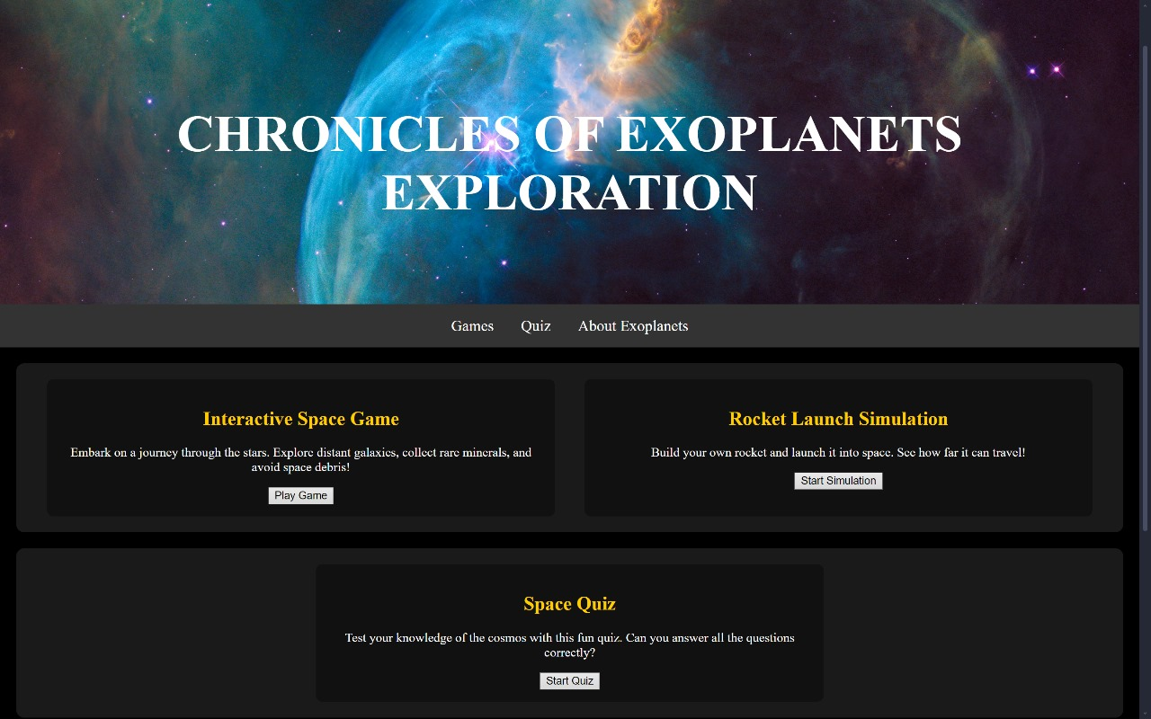
EXPLORE OUR APPLICATION: FEATURES AND ACCESS
CLICK THE LINK BELOW TO EXPLORE THE APPLICATION AND EMBARK ON THIS EDUCATIONAL JOURNEY!
HTTP://127.0.0.1:5500/HACKATHON_1/CHRONICLES.HTML

